Slide 1
Predicting single-family home prices using economic and social indicators
Ledia Dobi Conie o’Malley ITEC 621 SpRING 2025

Slide 2
Project framing
Project Framing
Data Description
Challenges
Modeling
Results
Conclusion

Slide 3
Project framing
Business Question
How can we use economic and social factors to predict the price of a single-family home?
Analytics Question
In our study, we aim to understand the effect that various economic (federal interest rate, median home sale prices, and others) and social (crime rates, unemployment rates) predicators have on the value of a single-family property. Our analytics question revolves around a quantitative outcome (price) and can be analyzed using quantitative methods, as the data will be numeric.

Slide 4
Description of the dataset
Zillow
Federal Reserve Economic Database
NYPD Crime Stats
Dummy Variables
median home sale prices,
federal interest rate
15-year mortgage rates,
30-year mortgage rates
NY median household income
national median household income
unemployment rates
new construction sales
mean home values
rental cost index
misdemeanor offenses
major felonies
non-seven major felonies
2008 Financial Crisis
COVID-19 Pandemic
Notes:
Non-seven major felonies: felony possession of stolen property, forgery/theft fraud/identity theft, arson, felony sex crimes, felony dangerous weapons, felony dangers drugs, felony criminal mischief & related offenses, other felonies

Slide 5
Complications/challenges
Addressing missing values
Standardizing all data to a monthly frequency, using averaging for variables reported at less frequent intervals
Ensuring data consistency and accuracy (dates, dimensions)

Slide 6
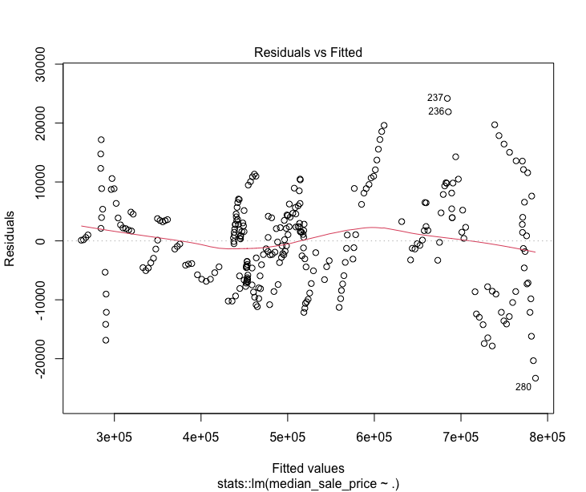
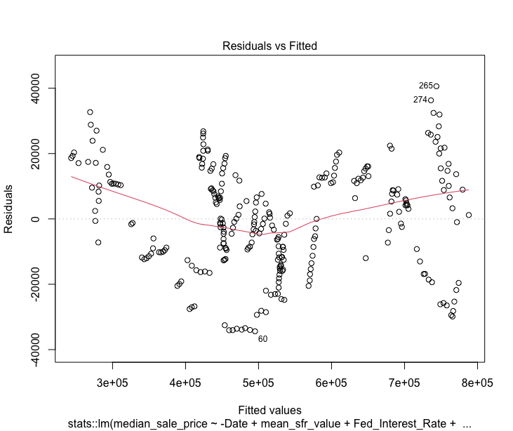
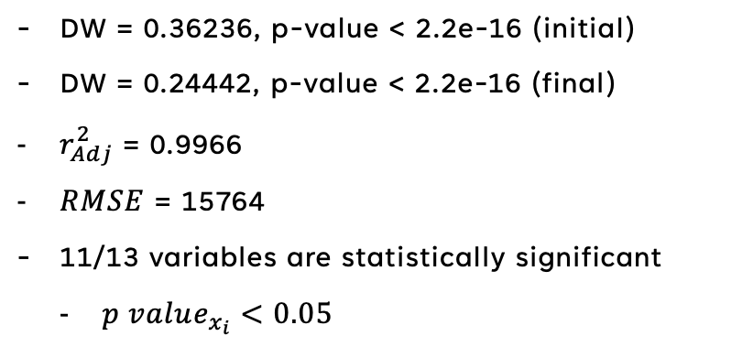
Explanation of model selection process, alternatives, model specifications
OLS
Fit an OLS model with all predictors and reduced based on p-value
Found heteroskedasticity and nonnormality
Typical for time series data
Created lagged date-related variables
Serial correlation persisted
Fig. 1 – Initial OLS Model Residual vs. Fitted Plot
Results
DW = 0.36236, p-value < 2.2e-16 (initial)
DW = 0.24442, p-value < 2.2e-16 (final)
$r_{Adj}^{2}$ = 0.9966
$RMSE$ = 15764
11/13 variables are statistically significant
$p value_{x_{i}}<0.05$
Fig. 2 – Final OLS Model Residual vs. Fitted Plot

Slide 7
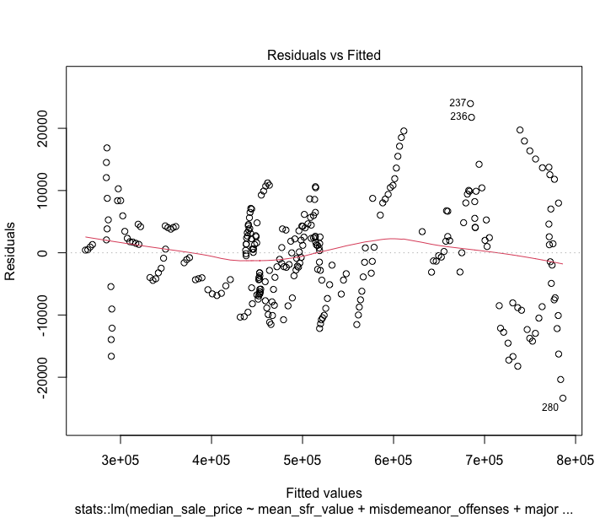
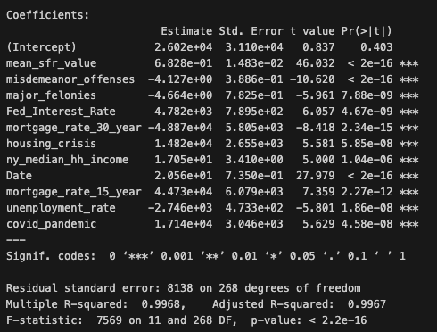
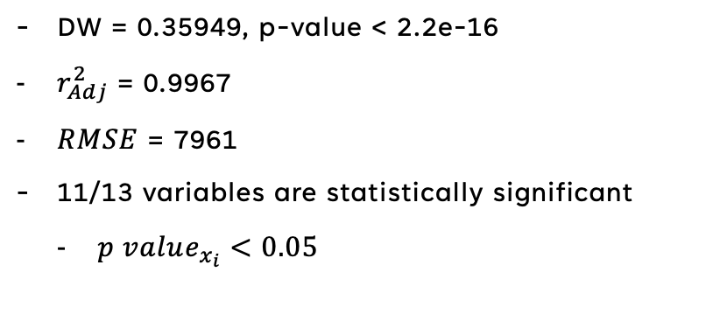
Explanation of model selection process, alternatives, model specifications
WLS
Fit a WLS model with all predictors and reduced based on stepwise regression
Continued to find heteroskedasticity and nonnormality
Improvement from final OLS Model
Transforming and lagging date-related variables but correlation persisted
Fig. 3 – WLS Model Residual vs. Fitted Plot
Results
DW = 0.35949, p-value < 2.2e-16
$r_{Adj}^{2}$ = 0.9967
$RMSE$ = 7961
11/13 variables are statistically significant
$p value_{x_{i}}<0.05$
Fig. 4 – WLS Summary Statistics

Slide 8
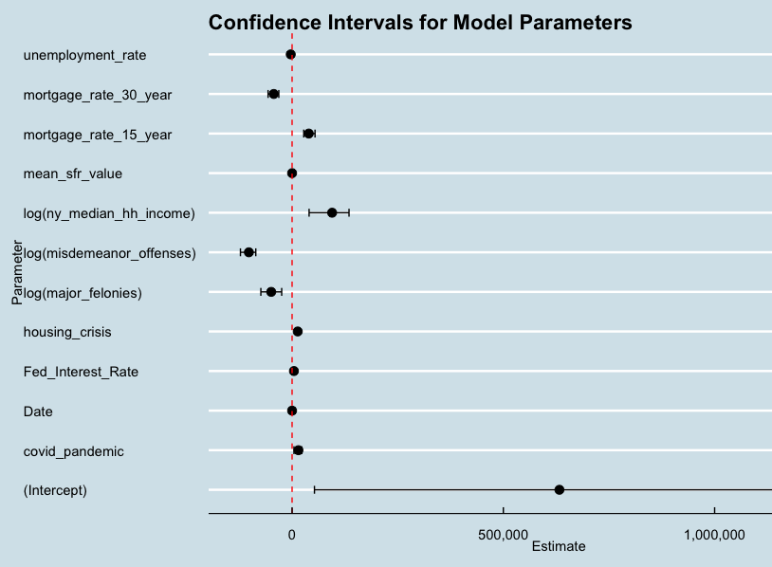
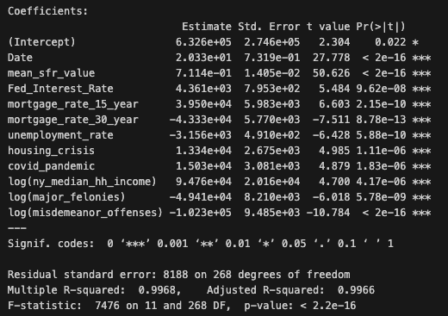
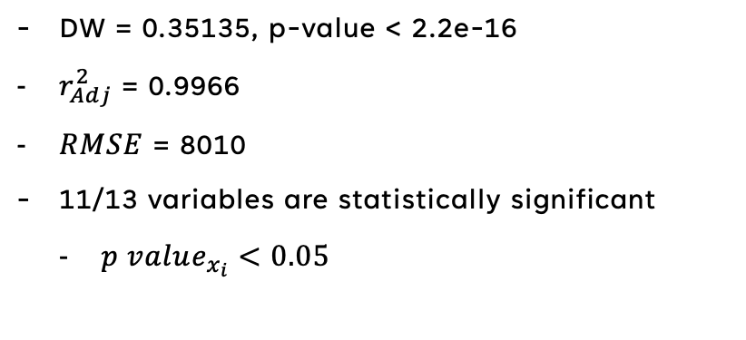
Explanation of model selection process, alternatives, model specifications
Bootstrap
Performed log transformation on yearly variables converted to monthly (crime, income)
Confidence interval plot for each parameter support accurate coefficient estimates
None cross the 0 line (indicative of an inaccurate predictor coefficient)
Fig. 5 –Bootstrap Confidence Interval Plot
Results
DW = 0.35135, p-value < 2.2e-16
$r_{Adj}^{2}$ = 0.9966
$RMSE$ = 8010
11/13 variables are statistically significant
$p value_{x_{i}}<0.05$
Fig. 6 – Final Model Summary Statistics

Slide 9
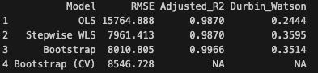
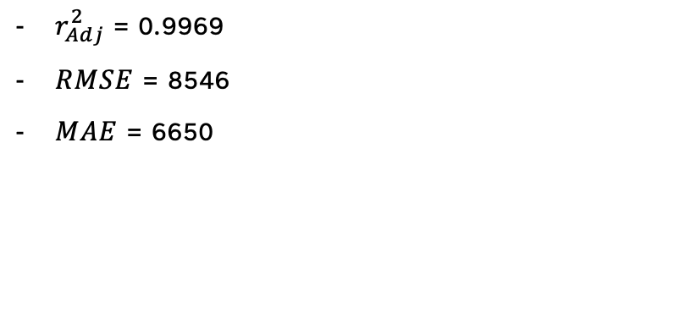
Explanation of model selection process, alternatives, model specifications
Cross Validation
Performed 10-fold Cross Validation on final model after bootstrapping
We had to perform inline calculations for log transformed variables
Typical for time series data
Transforming and lagging date-related variables but correlation persisted
Results
Fig. 6 – Model Comparison Table
$r_{Adj}^{2}$ = 0.9969
$RMSE$ = 8546
$MAE$ = 6650

Slide 10
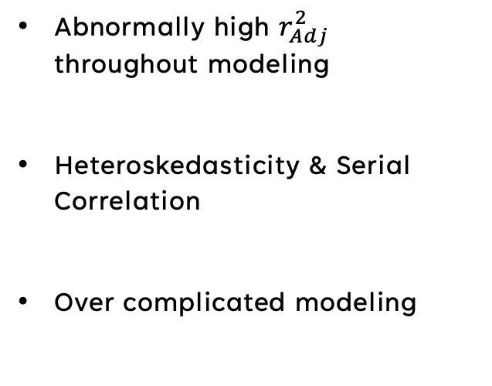
Relevant results
Results
Implications
Abnormally high $r_{Adj}^{2}$ throughout modeling
Heteroskedasticity & Serial Correlation
Over complicated modeling
Variable selection - review data selection process and try to be more creative with variables that could be explanatory (e.g., COVID Pandemic, 2008 Financial Crisis)
Variable selection – lots of data was correlated and we attempted to correct for this, but could not eliminate all the problems with heteroskedasticity & serial correlation
Variable selection – being able to cut down on variables that may not be necessary to simplify the model (even if variables are statistically significant or anecdotally significant)

Slide 11

conclusion
Results
Implications
We were able to identify key predictors (mortgage rates, federal interest rates, etc)
Our models explain 99.66% of the variance; major explanatory power
Still suffer from serial correlation and heteroskedasticity
Future work can build upon this and integrate additional variables in an attempt to offset the serial correlation.
We hope this research provides a comprehensive framework that key stakeholders can use to make information decisions about the housing market.

